Slide 1
Week 4 Class 2:
Influence
INST408C: Cognitive Security | Fall 2021 | SJ Terp

Slide 2
Week 4
Monday
Human system vulnerabilities and patches
From clicks to disinformation
cognitive biases and their abuses
the range of ways users and groups are influenced online (and offline via online means) - user experience, marketing and adtech, online political campaigns, astroturfing, online psyops, disinformation campaigns.
Wednesday
Psychology of influence
Outcome: articulate common influence techniques.
Applying marketing models
The medium is the message: Content vs Context

Slide 3
Definitions

Slide 4
Influence
“the capacity to have an effect on the character, development, or behavior of someone or something, or the effect itself.”
1: the power or capacity of causing an effect in indirect or intangible ways
2a: the act or power of producing an effect without apparent exertion of force or direct exercise of command
2b: corrupt interference with authority for personal gain
Notes:
Links:
Quotes from Merriam-webster
https://www.merriam-webster.com/dictionary/influence

Slide 5
Social engineering
“Psychological manipulation of people into performing actions or divulging confidential information”

Slide 6
Influence: landscape changes

Slide 7
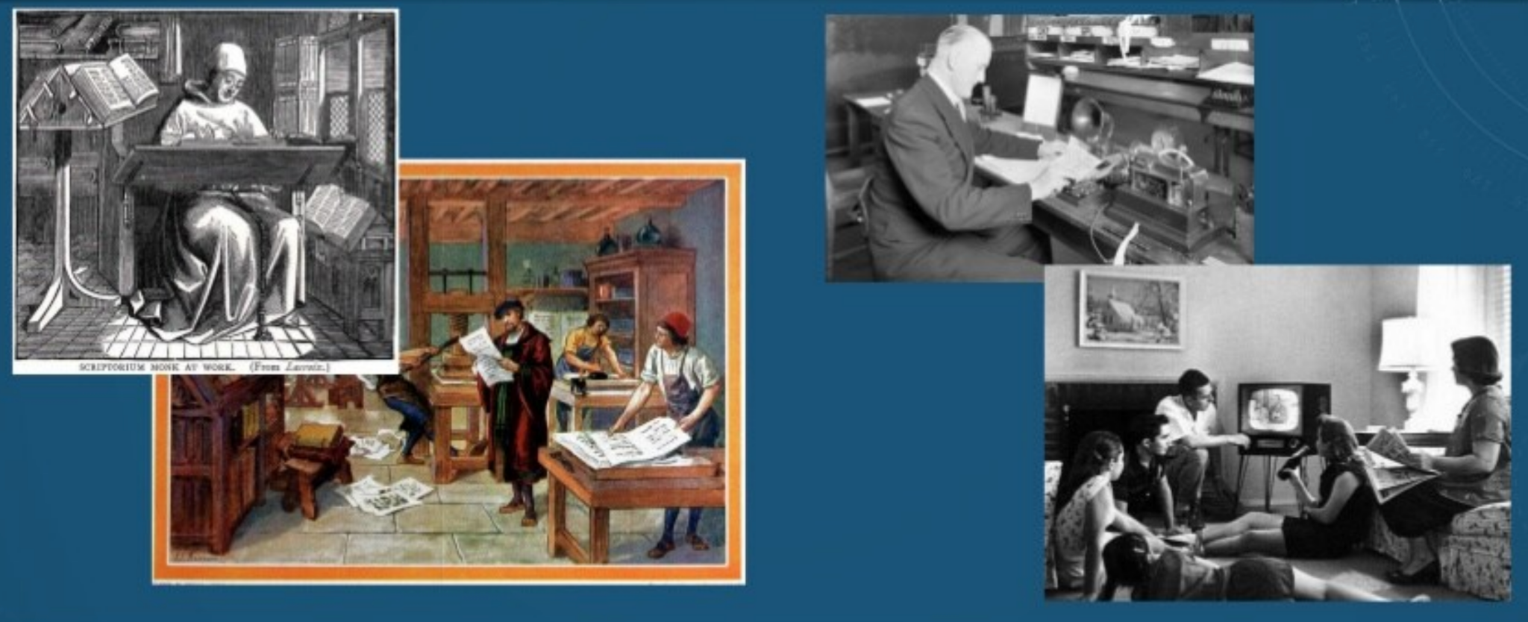
Evolution of information

Slide 8
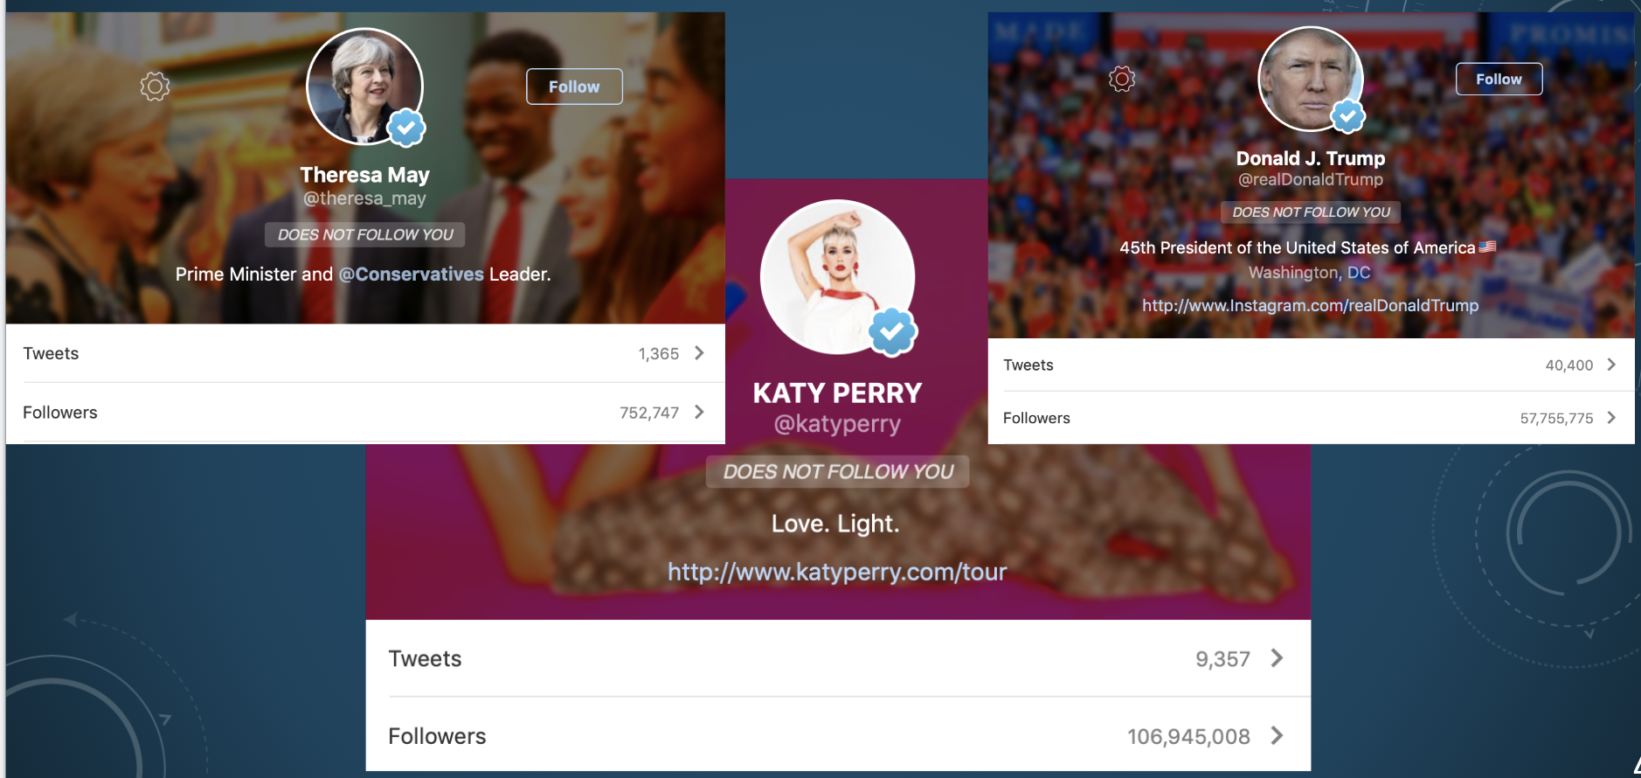
Online Influencers

Slide 9
Influence: advertising

Slide 10
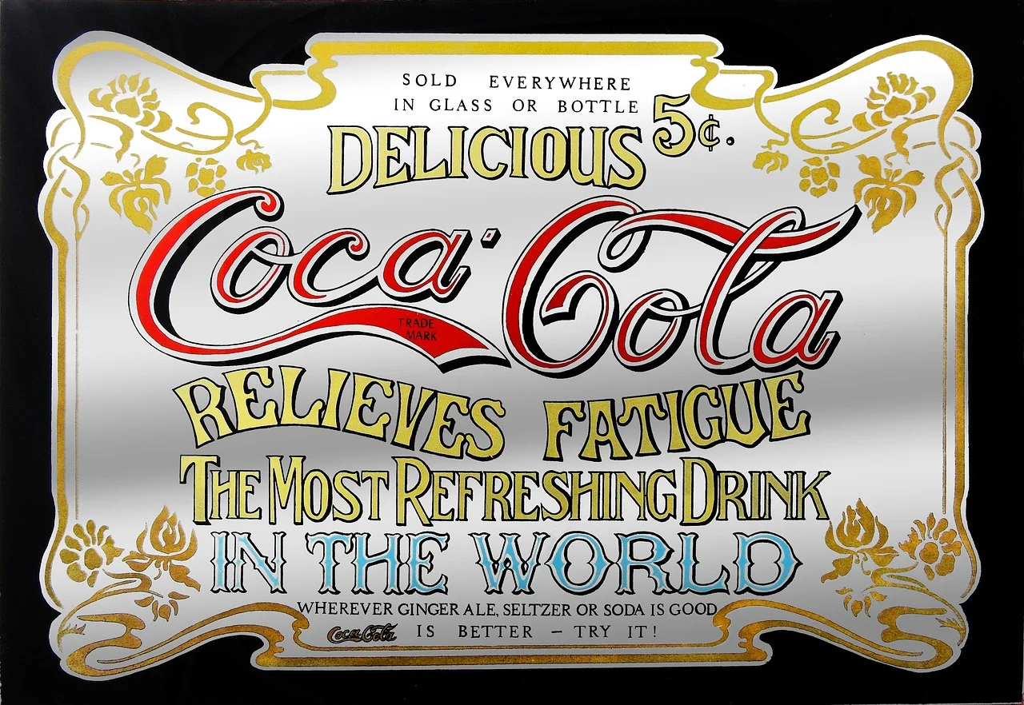
Advertisers
Notes:
Let’s start with advertisers

Slide 11
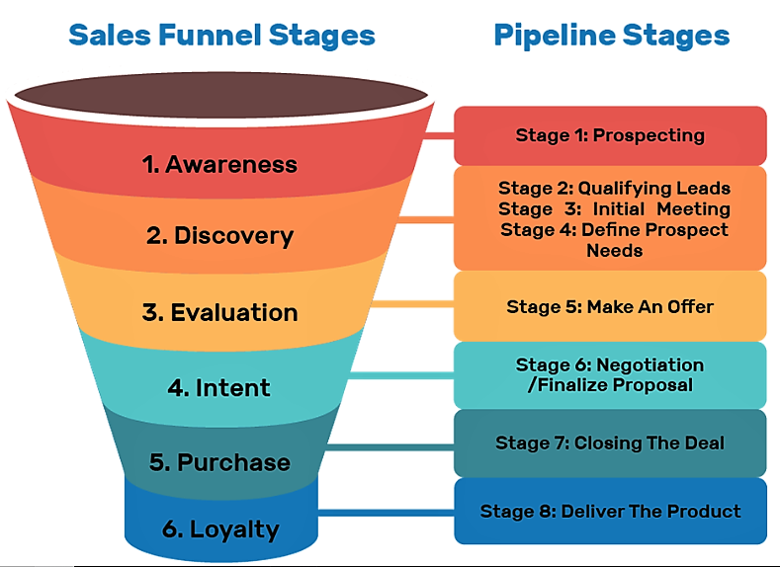
Sales funnels
Notes:
A sales funnel shows the stages that someone goes through, from being aware of a product to buying it
Links:
https://suzanneperkinsm.medium.com/what-is-a-sales-funnel-and-why-websites-dont-work-anymore-1450fc99e69b

Slide 12
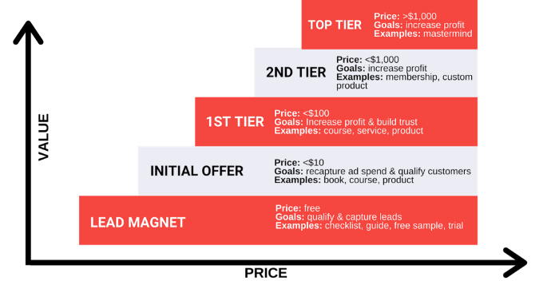
Value ladders
Notes:
http://suzanneperkinsm.com/what-is-a-value-ladder-and-why-do-you-need-one-for-your-business/

Slide 13
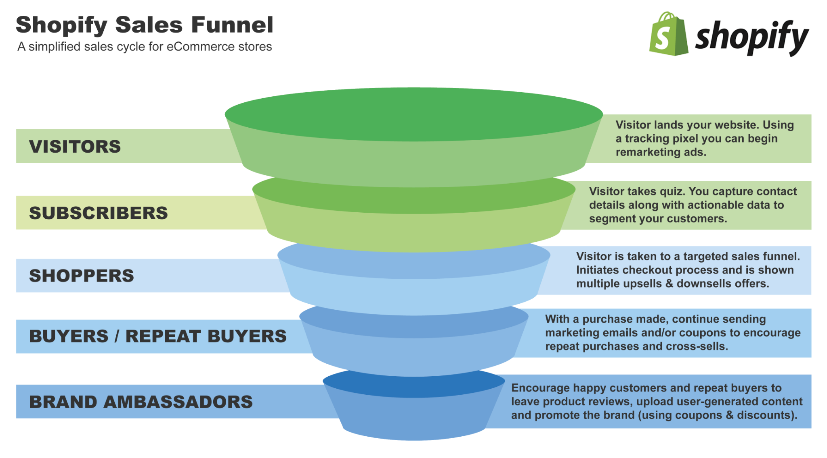
Customer types
Notes:
Image: https://revenuehunt.com/build-sales-funnel-shopify-store/

Slide 14
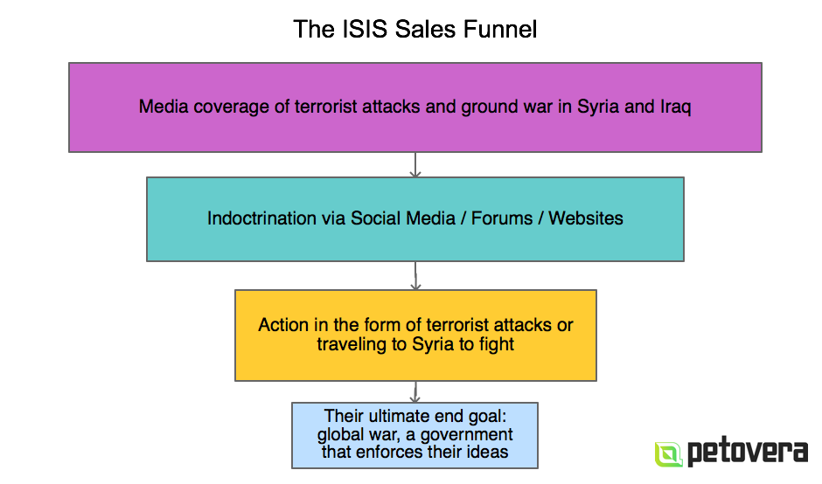
Why does this matter? Extremism sales funnels
Notes:
Image: https://www.autogrow.co/the-evil-isis-sales-funnel-deconstructed/

Slide 15
Influence: Marketing

Slide 16
Marketing and PR
“Influence to me is being able to control what someone sees about you - which then leads to you being able to control what they think about you. So PR is organized truth” - Ulysses Osuna, Influencer Press
Notes:
Links
https://www.forbes.com/sites/cognitiveworld/2019/10/04/the-art-of-online-influence/?sh=457a490847ef
https://www.ytcstudios.com/blog/2020/10/5/the-influence-of-fake-news-on-marketing
https://www.dictionary.com/browse/the-medium-is-the-message

Slide 17
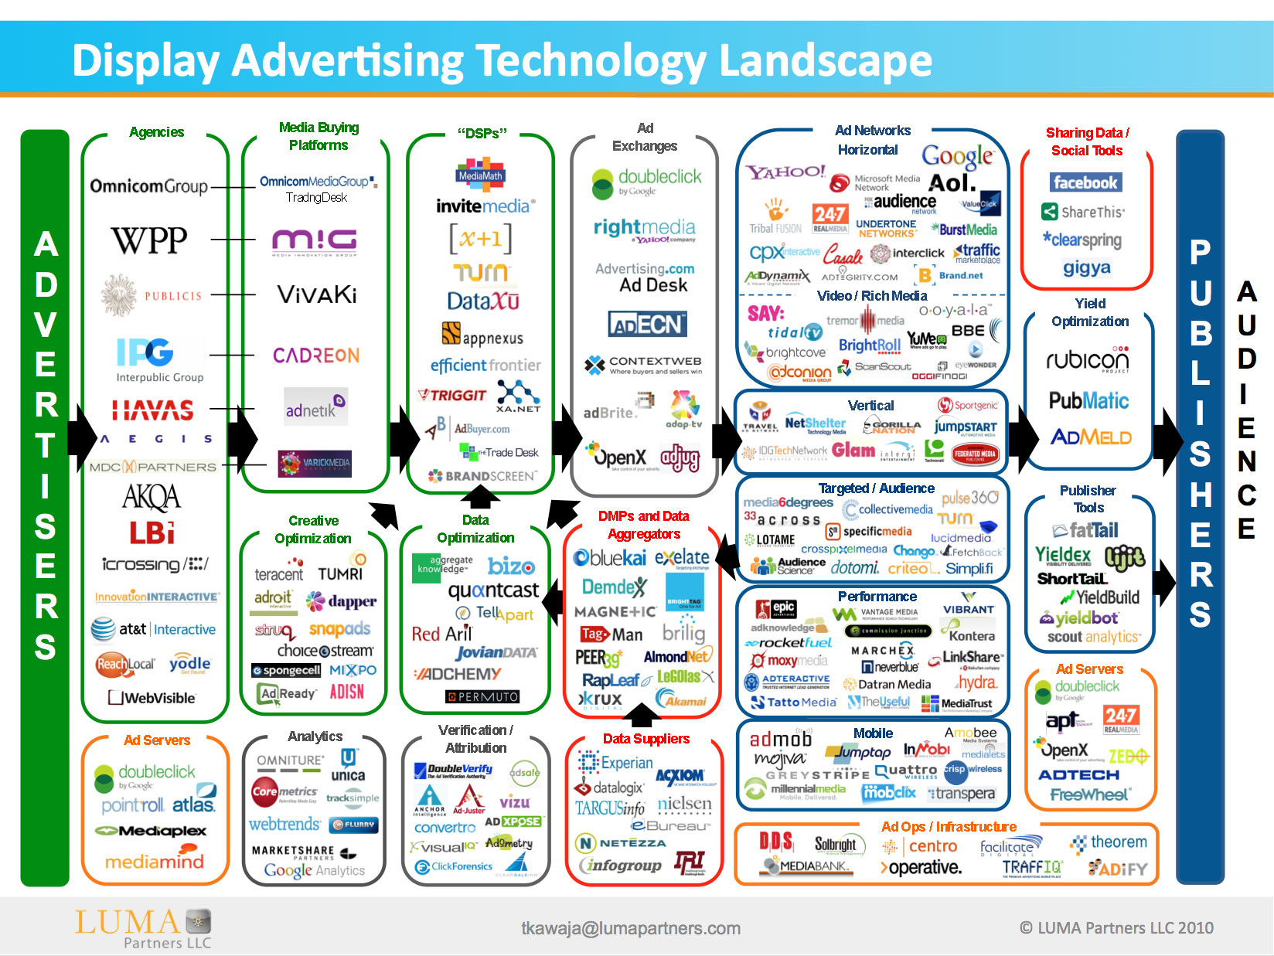
AdTech industry
Notes:
Image: https://www.adexchanger.com/venture-capital/ecosystem-map-luma-partners-kawaja/

Slide 18
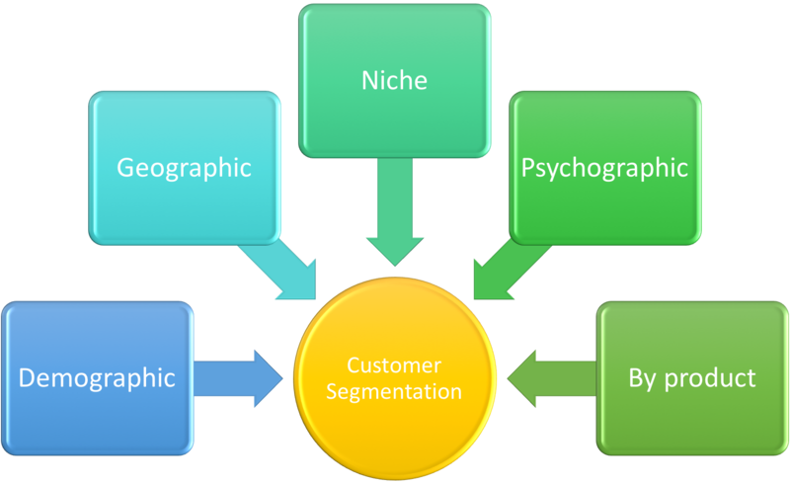
Customer segmentation and targetting
Notes:
Image: https://commons.wikimedia.org/wiki/File:Customer_Segmentation.png

Slide 19
Influence: geopolitics

Slide 20

Westphalian sovereignty
Each nation has sovereignty over its own territory and domestic affairs
Principal of non-interference in another country’s domestic affairs
Each state is equal under international law

Slide 21
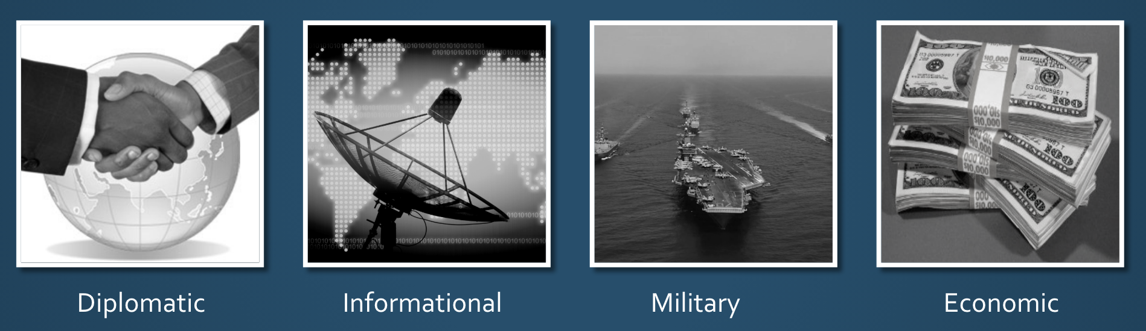
National instruments of influence
Notes:
Resources available to influence other states

Slide 22
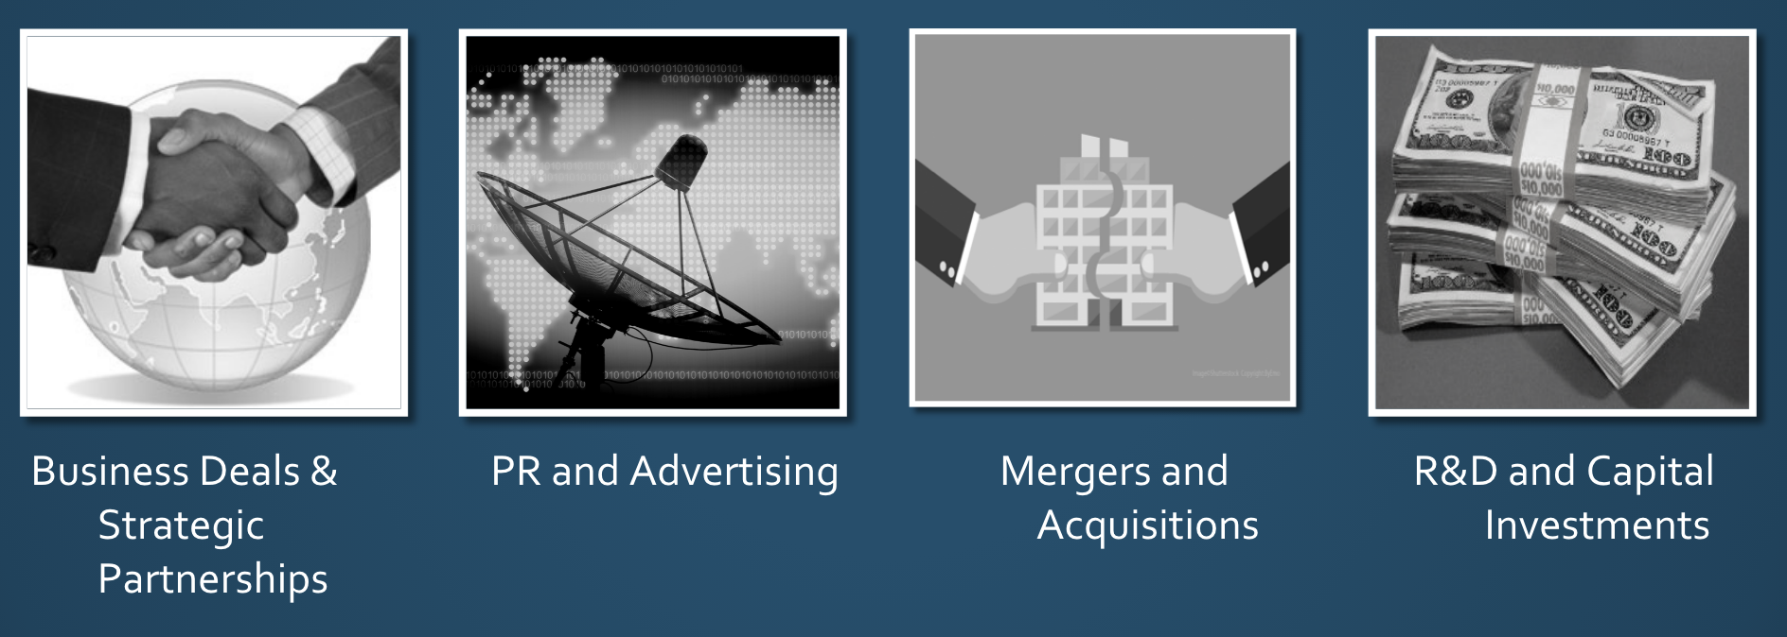
Business instruments of influence

Slide 23
Information threats
Democracy
Require common political knowledge
Who the rulers are
Legitimacy of the rulers
How government works
Draw on contested political knowledge to solve problems
Vulnerable to attacks on common political knowledge
Autocracy
Actively suppress common political knowledge
Benefit from contested political knowledge
Vulnerable to attacks on the monopoly of common political knowledge
Notes:
https://www.schneier.com/blog/archives/2018/11/information_att.html

Slide 24
Influence: politics

Slide 25
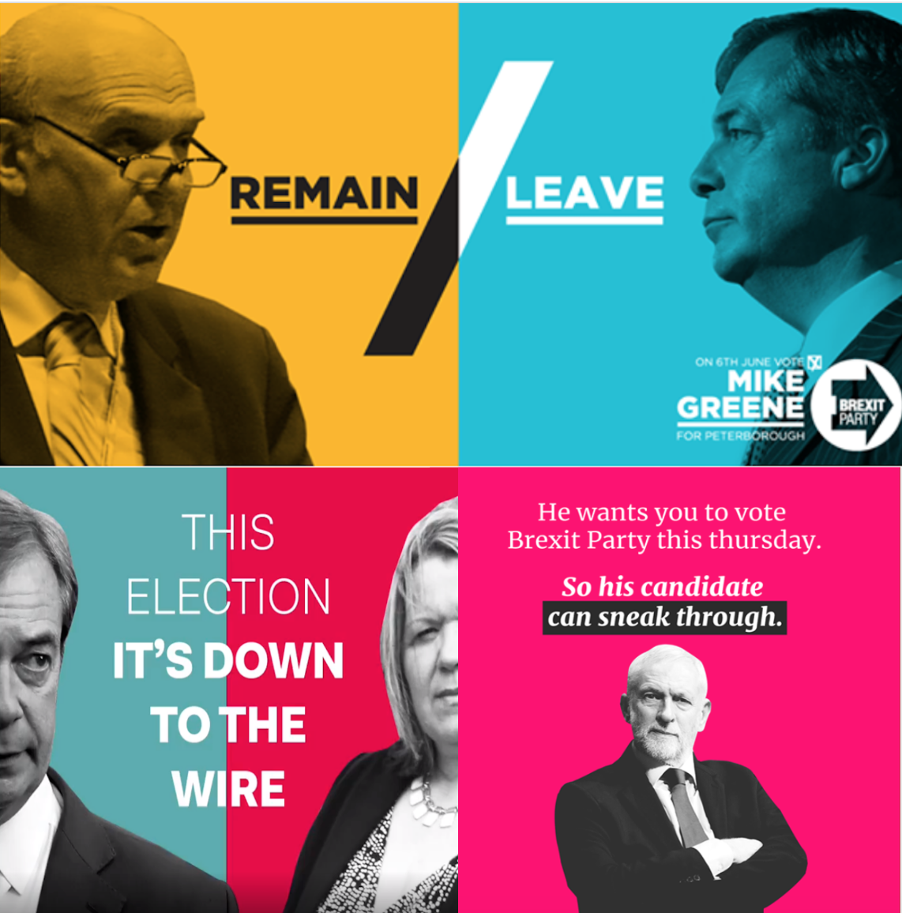
Political campaigns

Slide 26
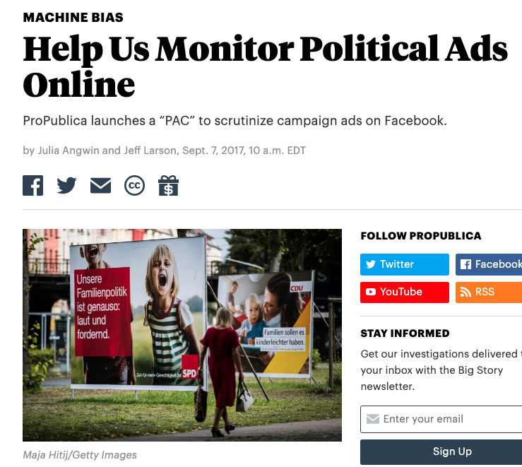
Political ads

Slide 27
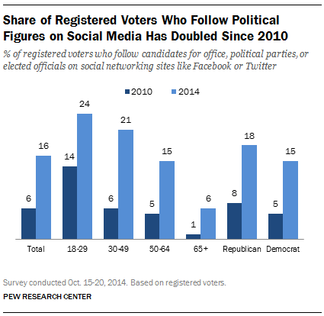
Social media
Notes:
Image: https://www.pewresearch.org/fact-tank/2015/05/19/more-americans-are-using-social-media-to-connect-with-politicians/

Slide 28
Influence: cyberspace

Slide 29
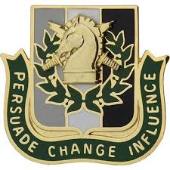
Psyops, disinformation, misinformation etc
Notes:
Image: US army psyops

Slide 30
Most cyberspace operations are based on influence
Force an adversary to make a decision or take an action based on:
Information I hide
Information I give
Information I change
Information I deny/degrade
Information I destroy
Enable my decisions based upon knowing yours
“Operations to convey selected information and indicators to audiences to influence their emotions, motives, and objectives reasoning, and ultimately the behavior of governments, organizations, groups, and individuals”

Slide 31
Not forgetting…

Slide 32
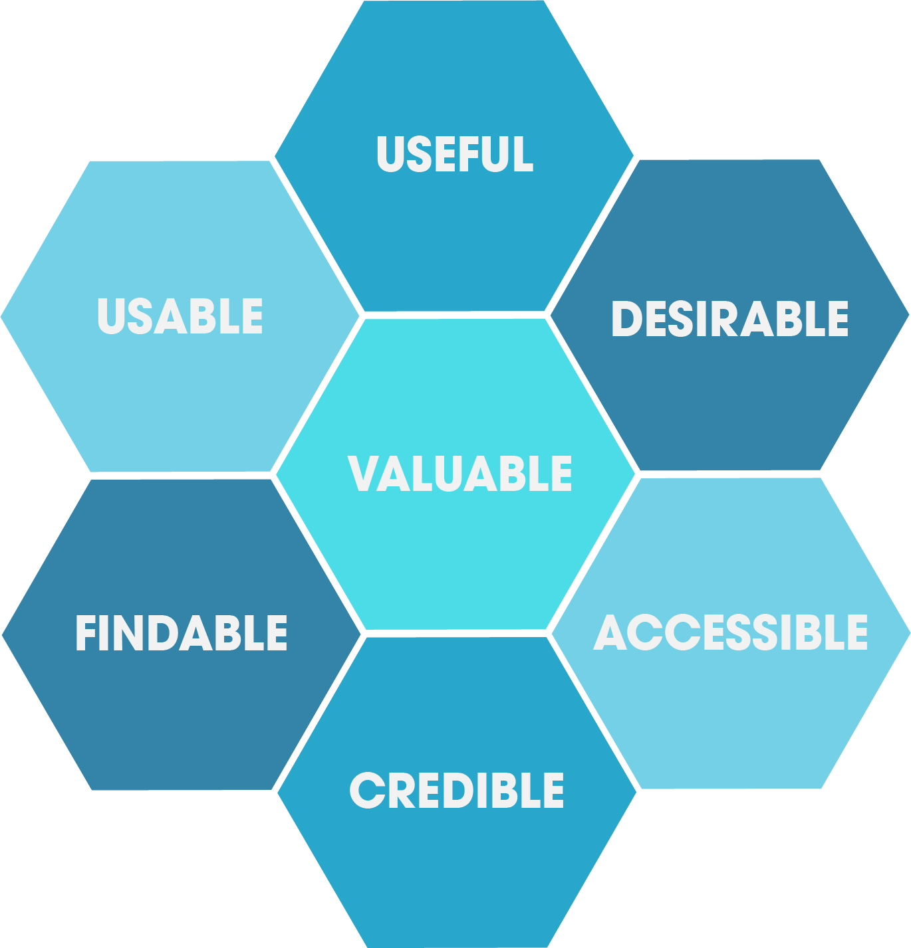
User experience designers

Slide 33
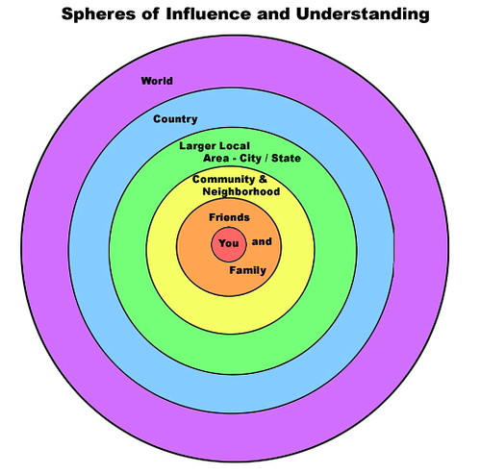
Friends, family etc
Notes:
Image: https://www.flickr.com/photos/veraciousjess/284998971

Slide 34
Influence: how

Slide 35
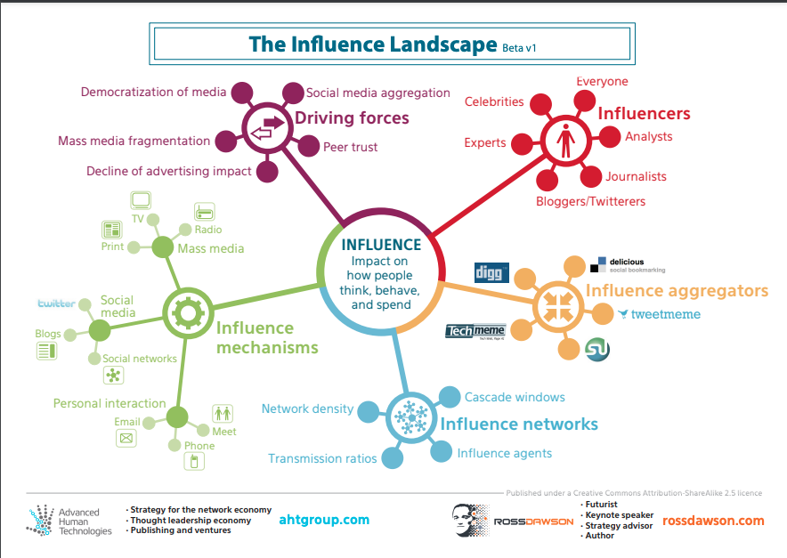
Changes in influence
Notes:
Image: https://www.rossdawsonblog.com/Influence_Landscape_Beta_v1.pdf

Slide 36
The medium is the message
McLuhan’s “The medium is the message”: the forms and methods used to communicate information have a significant impact on the messages they deliver (including meanings and perceptions”
“Never mind the content; what’s important is the medium… the media are extensions of our senses; as they change, they transform our environment and affect everything we do -- they “massage” or reshape us” - McLuhan

Slide 37
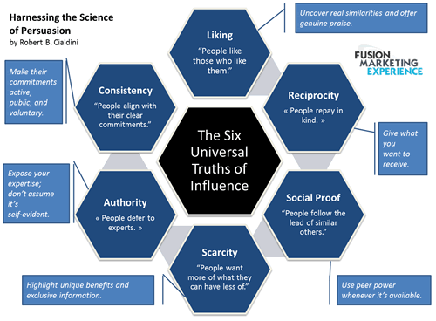
Using those biases

Slide 38
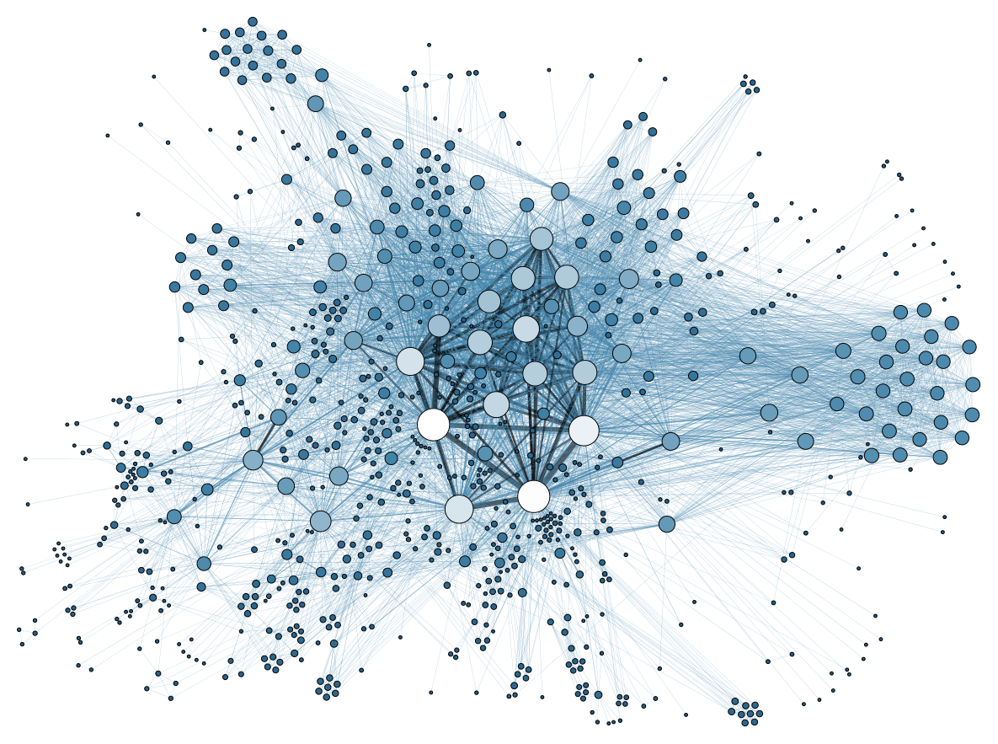
Network contagion
Notes:
Links
Image: https://commons.wikimedia.org/wiki/File:Social_Network_Analysis_Visualization.png
Paper to check out: https://www.pnas.org/content/106/51/21544

